Slide 1
Project 3 ILI (Influenza like illness) in the united states
Chris
Erik
Jamie
Brandon

Slide 2
We reviewed ili data from 2010 to current and broke it down by state and strain.

Slide 3
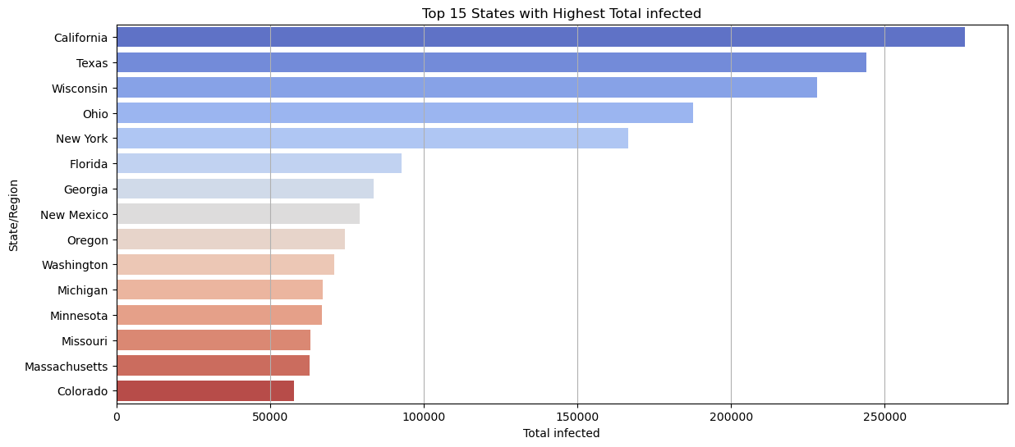
Over the past 15 years, the top 5 states with the highest infection: California, Texas, Wisconsin, Ohio and New York

Slide 4
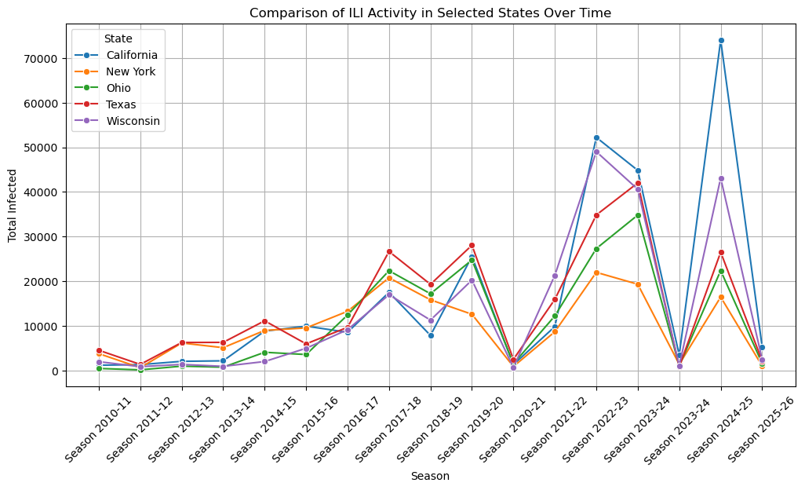
This chart compares the seasons over the last 15 years.
The 2023-2024 season had the highest number of Influenza like illness with the 2021-2022 not far behind

Slide 5
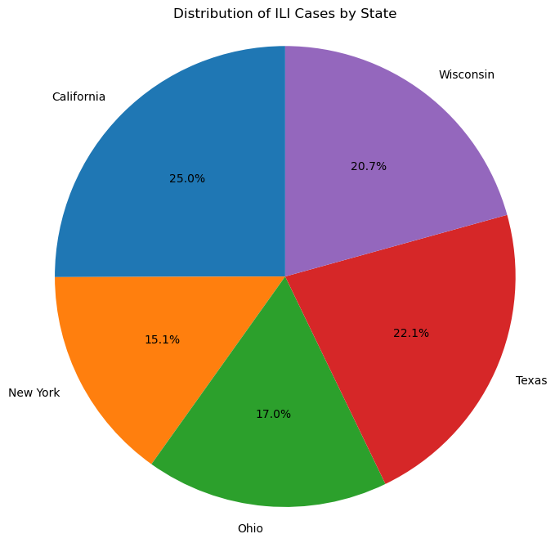
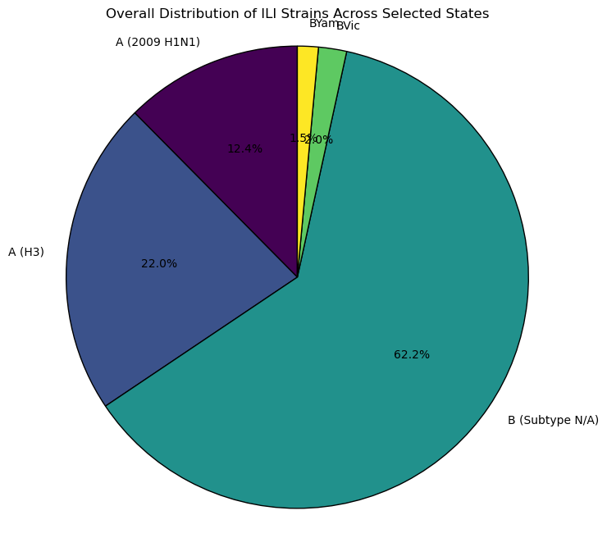
On the left we have the top 5 states with the highest Influenza like illness over the last 15 years.
On the right a breakdown of the different strains of ILI of the top 5 states in the country.

Slide 6
We have gathered data from the last 15 years of ILI to create our charts. Our bar chart we created will give you and in depth view of the states with the highest total ILI. The line graph we created will guide you through the last 15 years and show you the years that were hit the hardest with ILI throughout the U.S. The first pie chart breaks down the top 5 U.S. states by what percentage of the U.S. they cover with ILI. Lastly, the second pie chart breaks down the types of strain percentages of ILI throughout the top 5 states in the country.

